Slide 1
Title slide – Institute for Community Inclusion and Partners

Slide 2
Engaging with Businesses to Create Great Job Matches
Work In Progress: Employment and Community Life
MA DDS Conference
May 15, 2025

Slide 3
The Arc Title Slide

Slide 4
Who Am I?
Adam Belmore, CESP
Director of Employment Services
Arc of Greater Brockton
1215 West Chestnut Street Brockton, MA 02301
Certified Employment Support Professional
B.S. of Psychology from Bridgewater State University
Worked in Employment Services for 10 years
Providing services to 100+ clients in Greater Brockton Area

Slide 5
Prepare the Pitch and Set the Meeting
Designing the Pitch
Identify program strengths
Clearly describe services provided
Outline program structure and capabilities
Marketing material
Scheduling the Meeting
Research the company
Set time and space for maximized attention
Request tour with meeting
Know who you are meeting with

Slide 6
In The Meeting
Professionalism
Demonstrate value to the company
Positive language
Honest descriptions
Guage the response
Exploring all possibilities

Slide 7
Build Trust
Explain history
Leverage networking
Provide success stories
Address concerns

Slide 8
Planning for Long Term
Emphasize building a partnership
Think sustainability
Anticipate future hiring needs or issues
Follow up and follow through
Offer public relations benefits

Slide 9
Thank You Slide
Thank You!
www.arcofgreaterbrockton.org

Slide 10
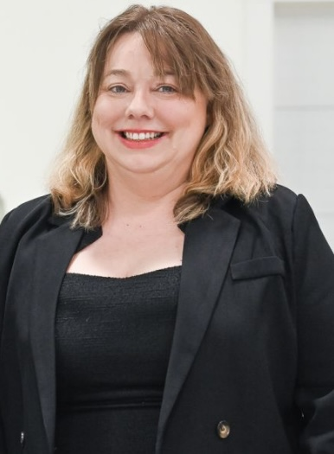
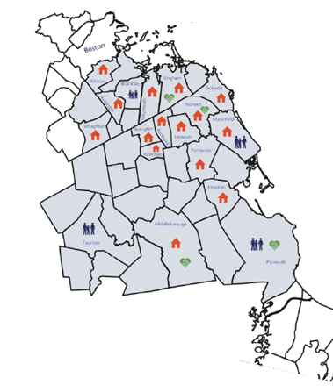
Road to Responsibility, Inc. Making Lives Better… One person at a time
Networking that works!
How Building Relationships Creates Opportunities.
Presented by:
Liz Taylor-Lindsay, Career Specialist
1831 Ocean Street Marshfield, MA 02050
roadtoresponsibility.org
781-834-1300
Notes:
Slide 1: How Networking Started for Me
Hi, my name is Liz Taylor Lindsay. I’m a Career Specialist at Road to Responsibility. I’m excited to share how networking has become one of the most valuable tools in my work. - Met an end-of-life doula at a business expo
- Invited to a business networking group
- Discovered new industries and opportunities
- Built trust and lasting business relationships

Slide 11
How Networking Helps Me as a Career Specialist
Notes:
- Learn business needs, trends, and hiring goals
- Build employer trust through education and outreach
- Gain early insight into job openings
- Create mock interviews, referrals, and mentorships

Slide 12
Networking Impact for Job Seekers
Notes:
Job seekers gain skills and confidence
- Discover hidden talents and interests
- Connect through shared community ties
- Use assistive tech to overcome challenges

Slide 13
Expanding the Network & Creativity
Notes:
- Attend community events, expos, and local clubs
- Use social media and LinkedIn for leads
- Job seekers can network too: About Me sheets, volunteering
Discover career paths, learn steps to move forward
Think outside the box

Slide 14
5 Networking in Action
Notes:
- Hosted an inclusive library event through networking
- Arranged a casual job tour with behind-the-scenes access
- Built trust, visibility, and long-term support systems
You are the connector who makes it all work
Please feel free to connect with me on LinkedIn.
Thank you for your time

Slide 15
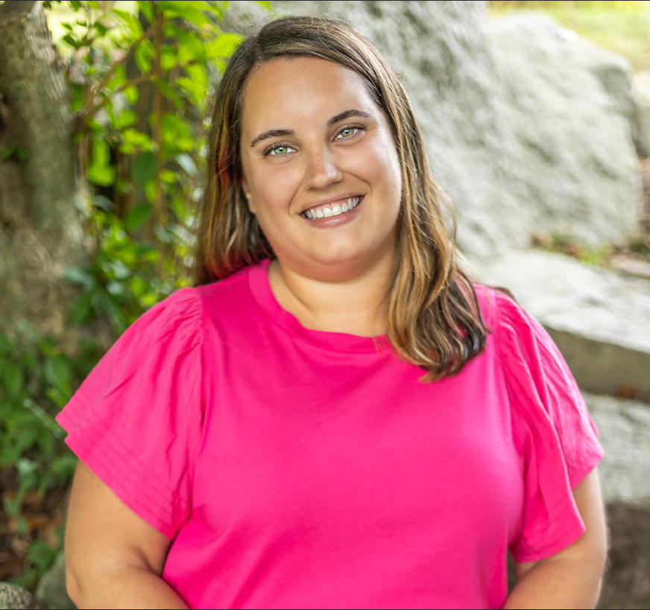
Emily Shea
Director of Supported Employment
Grow Associate

Slide 16
Meet Kelly
New client to GROW Associates
Employment at local daycare center for 7+ years
Wanting a change of pace to fit her new environment, her mother was unsure about making the change
Love of animals, what to do? Who to call?

Slide 17
Cold Calling
Petco Avon due to previous volunteer work through Grow
Referred to Petco Quincy, Gary / Assistant Manager
Set up job tour with 4 individuals

Slide 18
Job Tour
Review of all exhibits: cleaning, care, feeding, maintenance
Stocking & inventory
Customer service
Grooming salon
Register: training mode

Slide 19
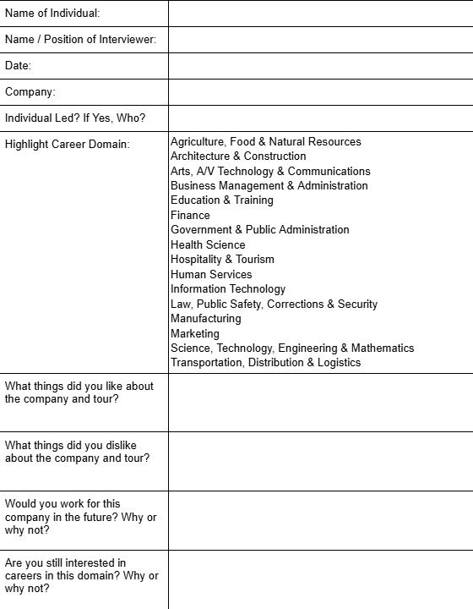
Reflection
Reflection form
Not a perfect fit for everyone… That’s okay!
Where to go from here?

Slide 20
Alexis Manuel Employment Specialist Institute for Community Inclusion

Slide 21
Getting to Know Your Job Seeker
Getting to know who they are as a whole person and meeting them where they are.
Getting to know their past work/volunteer experience.
Getting to know their neighborhood and places they enjoy shopping at or visiting.

Slide 22
Connecting With The Employer Our goal is to build meaningful and collaborative partnerships with employers .
Initiate contact
Initiate contact
Communicate our role
Understand employer needs
Match with strengths
Offer ongoing support
This approach leads to better job matches, stronger retention, and a more inclusive workplace.

Slide 23
Connecting With The Employer
Communicate our role
Understand employer needs
Match with strengths
Offer ongoing support
This approach leads to better job matches, stronger retention, and a more inclusive workplace.
Connecting With The Employer Our goal is to build meaningful and collaborative partnerships with employers .

Slide 24
Creating The Right Fit
Understanding the employers needs
Assessing the job seekers strengths
Developing a tailored role
Facilitating role creation
Why it matters:
Enhances job satisfaction
Improves retention
Strengthens employer partnership

Slide 25
Success in Employment
Key Highlights:
Versatile role: our client assist across multiple departments, adapting to the stores evolving needs.
Collaborative Support: Employment specialist actively engages with both the client and employer to ensure mutual satisfaction and success
Inclusive accommodations: implementing tailored accommodations that have enhanced the accessibility for all employees.

